Slide 1

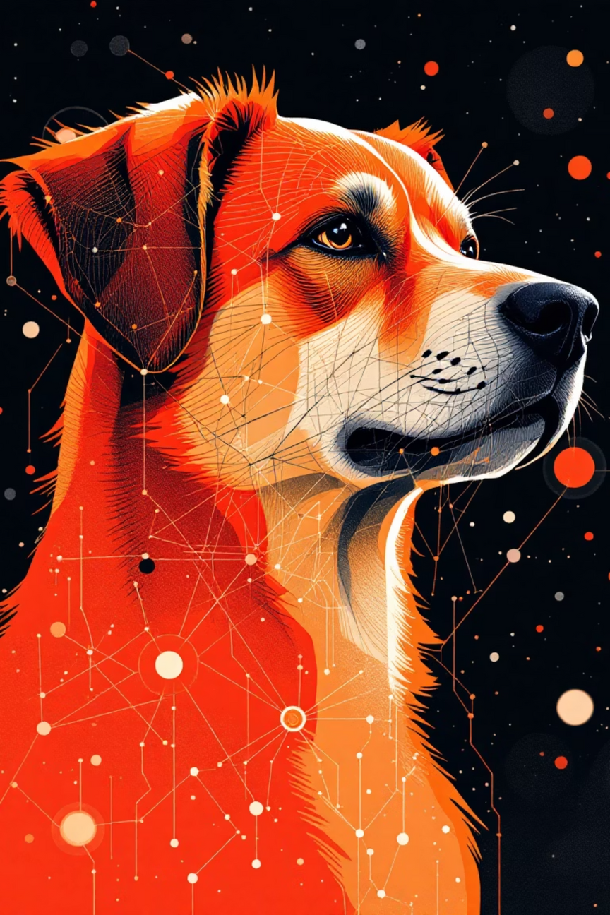
PawPredict
AI Model for Dog Breed Detection and Information Generation

Slide 2

INTRODUCTION
Problem Statement
Identifying dog breeds accurately is often challenging for pet owners, especially in the case of rescued or mixed-breed dogs.
Traditional identification methods depend on expert consultation or DNA testing, which are costly and time-consuming.
There is a growing need for an accessible, user-friendly digital solution that can quickly recognize dog breeds and provide reliable breed information.
Solution
pawpredict offers an instant and convenient way for users to identify their dog’s breed through a simple image upload.
The system predicts the breed using a trained model and provides detailed breed information and similar breed suggestions.
With an intuitive interface and the Pawdium feature, users can explore, learn, and even showcase their pets effortlessly.

Slide 3


Technology Stack
A modern, scalable architecture combining cutting-edge frontend frameworks with a robust Python backend.
Frontend :
Backend :
React + Vite + Tailwind – responsive UI with real-time results.
FastAPI (Python) – serves model predictions via REST API.
Database :
Authentication :
MongoDB – stores user data, predictions, and vaccination records.
Encrypted sign-in and session management.
AI Model :
EfficientNet-B2 – pre-trained for dog breed detection.

Slide 4


End-to-End Prediction Flow
A seamlessly integrated process from user authentication through secure AI inference to persistent data storage.
User Sign-in
Upload Photo
Image Processing
AI Inference

Slide 5






Application Features
Comprehensive functionality spanning breed identification, pet management, educational content, and user engagement.
Breed Identification
PredictionPage and BreedDetailPage for instant, accurate results
Breed Directory
Searchable catalogue of 120+ dog breeds with detailed information
Nearby Vet Tracking
It have help desk that contains nearby vets information and also about pet food stores
User Engagement
Prediction history, feedback system, and FAQ section

Slide 6


Challenges: Performance & Scalability
Challenge
Solution: Model Optimisation
Maintaining sophisticated AI model accuracy and speed under escalating user load whilst minimizing infrastructure costs and latency.
EfficientNetV2-B2 architecture provides 95.2% accuracy with only 7.2M parameters. Quantisation and distillation techniques further reduce computational overhead.
Solution: Frontend Optimisation
Unified Authentication
React code splitting, lazy loading, and request batching minimise latency. API calls are optimised to eliminate redundancy and maximise cache efficiency.
Clerk provides enterprise-grade identity management, validated by Python backend, ensuring consistent user authentication across all services.

Slide 7
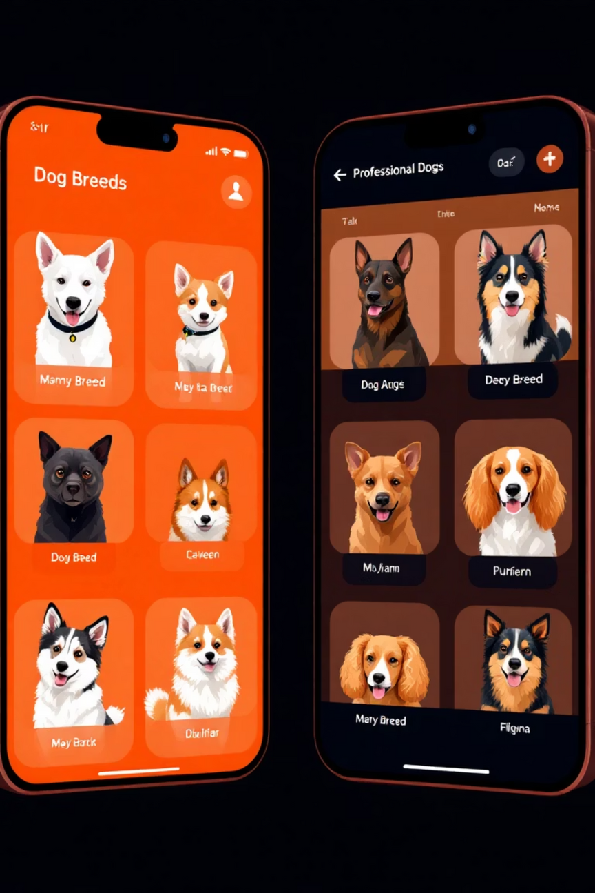

Future Enhancements (V1.1)
Native Mobile Application
React Native development for iOS and Android platforms, delivering superior mobile accessibility and native device integration.
Batch Processing Capability
Enable identification of multiple dogs within single images or bulk uploads, significantly expanding use case applicability.
Advanced Breed Comparison & Directory
Powerful comparison tools and searchable breed database with health insights, care recommendations, and breed-specific information.

Slide 8

Conclusion
PawPredict provides a simple and engaging way to identify dog breeds instantly. It focuses on reliability, accessibility, and a smooth user experience. The platform encourages pet owners to explore and showcase their pets. We thank our mentors for their guidance and continuous support.
PawPredict reflects our commitment to creating meaningful and user-focused digital solutions. We look forward to enhancing it further and bringing more value to pet owners in the future.

Slide 9
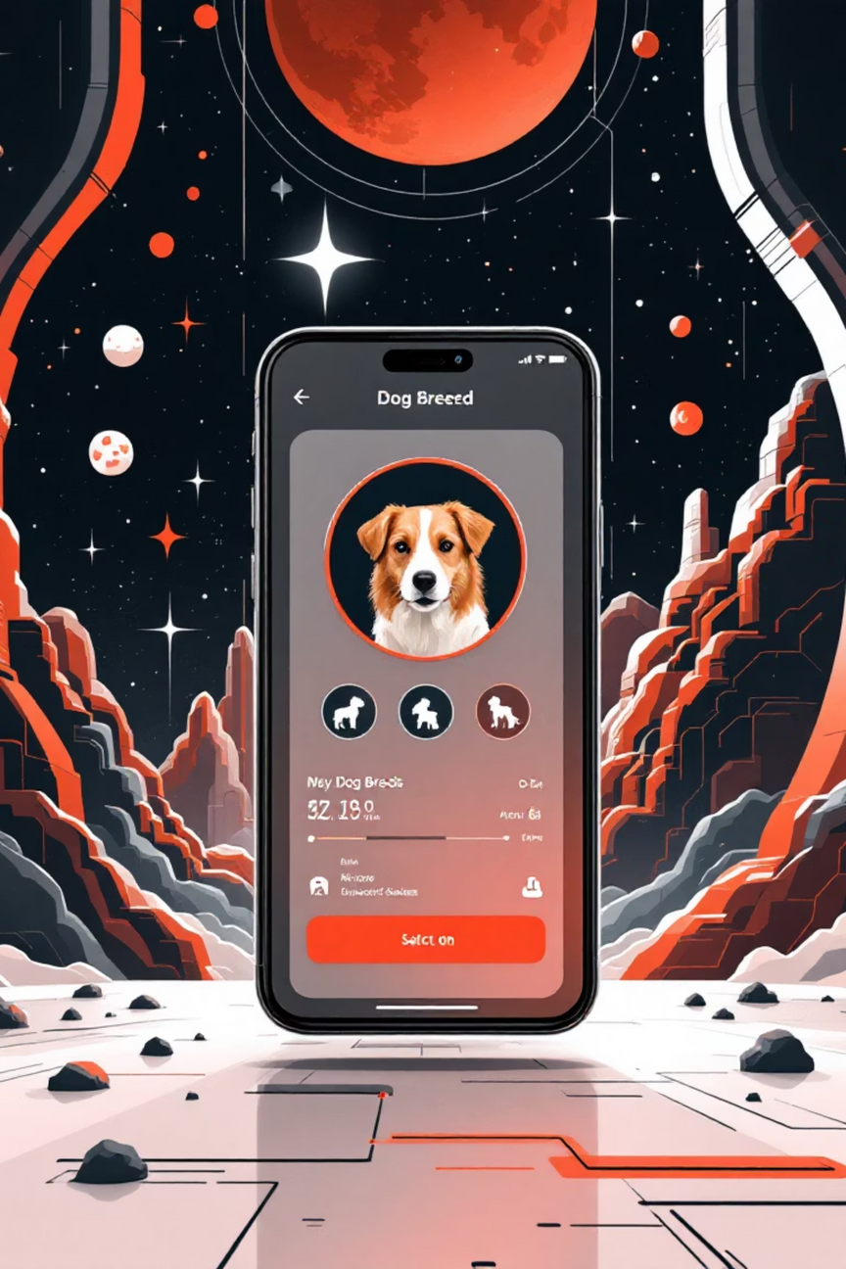
Live Demo Time! 🌟
We're excited to invite our Demonstration Team to showcase pawpredict in action. Get ready to see how our platform transforms the breed identification experience!
01
02
Instant Breed Recognition
Core Features Walkthrough
Watch how our system identifies dog breeds in real-time with remarkable accuracy
Explore the intuitive workflow and powerful capabilities built into every interaction
PAWPREDICT
Thank You

